Slide 1
Cancellation in JavaScript
Token-based cancellation in JavaScript using the unifying .NET cancellation pattern
By Andrew Nosenko - @noseratio

Slide 2
Intro
Cancellation is a pattern used to stop an asynchronous operation or a long-running synchronous operation.
.NET uses a unified model for cooperative cancellation, based on a lightweight object called a Cancellation Token, and it’s parent object called Cancellation Token Source.
Despite many takes, an established cancellation framework is somehow still missing in JavaScript world. The current TC39 proposal is based on the .NET model (it’s in the early stage 1).

Slide 3
Why is cancellation important?
It’s natural. Many real-life process can be interrupted by an external request.
It’s may be useful for developing front-end workflows.
It may also improve the scalability of the back-end, by stopping pending operations which are no longer relevant.
Proper cleanup and release of resources with try/catch/finally.
If implemented properly, cancellation is pervasive through all code layers and from the front-end to the back-end, similar to async/await itself.
Notes:
What is a workflow? In many case, the user interaction logic or business logic within our applications can be naturally described and implemented as a set of asynchronous processes that can be started and stopped (cancelled). Those can be sequential and concurrent.
I this talk by workflow I mean an async method. For more complex concepts, check out https://temporal.io.
Conversational UI workflow as a real-life example.

Slide 4
Autocomplete as a well-known example
The user types a character.
We start an async delay, e.g.: await new Promise(r => setTimeout(r));
When the delay is completed, we start and await a REST fetch call.
Meanwhile, the user may have typed another character, while we still haven't received the server's response for the fetch.
Ideally, we now should cancel the fetch (or the delay, whichever is pending), before we start a new sequence of these async calls.
On the server, we may also want to cancel a pending call to 3rd party microservice API that we use for auto-complete, to avoid extra charges
Now we can start another delay and the fetch for the newly entered text, and so on.

Slide 5
An overview of the .NET cancellation pattern
In a nutshell, the cancellation pattern in .NET deals with the following three parts:
The CancellationTokenSource. This is the producer part of the API, the code which triggers cancellation. It’s normally external to the asynchronous operation itself. The cancellation is requested via CancellationTokenSource.cancel().
The CancellationToken. This is the consumer part of the API, returned by CancellationTokenSource.Token, used to observe external cancelation requests.
A OperationCanceledException exception to tell the operation was cancelled.

Slide 6
Observing the cancellation request
A cancellation token lets the code conducting an long-running operation to observe the cancellation request and act upon it to end that operation.
We observe it via a callback registered with CancellationToken.register()
Think of it as of addEventListener for a hypothetical cancel event.
Back to our Autocomplete example, that’s where we may want to call clearTimer() and reject the delay promise, or call AbortController.abort() to cause the rejection of the fetch promise.
On tight loops, we may want to call CancellationToken.ThrowIfCancellationRequested() to poll for a cancellation requests.

Slide 7
Cancelling a hierarchy of async operations
Cancelling a complex tree or a graph of workflows is possible with linked token sources, created with CancellationTokenSource.CreateLinkedTokenSource(linkedTokens)
For example, we may want to create a new linked token source and pass its token to a child workflow we’re about to start (as later in the demo).
The child workflow then can be cancelled internally by the parent workflow (that created it), or as a part of the whole cancellation tree, if requested externally.

Slide 8
What’s up in the land of JavaScript?
Ben Lesh in his “Promise Cancellation Is Dead — Long Live Promise Cancellation!" article offers the following options:
Use Bluebird library
Use Another Promise (as a token)
Use Rx Subscriptions
Ditch promises and just use Observables
I might add that AbortController/AbortSignal/AbortError is being increasingly adopted by Node.js. I personally was looking for a library that already implements the .NET model for JavaScript, and I’ve found one: the Prex library.
Notes:
JavaScript is single-thread, but that doesn’t mean we can’t have async concurrency. What do you do when you want something from .NET in JavaScript?
You go to NPM.COM and search. Someone has done it before! 🙂

Slide 9
Promise Extensions for JavaScript (prex)
A library created by Ron Buckton, a Senior SDE for TypeScript, a member of TC39 committee and the author of the current ECMAScript Cancellation proposal.
Prex provides lots of async counterpart APIs for what we use and love in .NET, for example:
Deferred (.NET TaskCompletionSource);
Semaphore (.NET SemaphoreSlim);
AsyncQueue ( .NET Channel);
delay (.NET Delay);
And of course, for cancellation:
CancellationTokenSource , CancellationToken, CancelError (.NET OperationCanceledException)
Notes:
Rob’s GitHub also has other great libraries: @esfx (low level async primitives and adaptors) and iterable-query (LINQ-style fluent operators for JavaScript iterables).

Slide 10
Use token-based cancellation for native APIs
We can use CancellationTokenSource and CancellationToken to wrap many native cancellation and clean-up APIs in JavaScript, both in front-end and Node.js. For example:
AbortController and AbortSignal for HTTP fetch;
clearTimeout for setTimeout, cancelAnimationFrame for requestAnimationFrame
stream.end or stream.destroy in Node.js.
Cancelling gRPC calls
Notes:
AbortController doesn’t support hierarchical cancellation yet (what CreateLinkedTokenSource does in .NET), but the discussion in underway.
Advanced use: can possibly be integrated with Node.js Async Hooks.

Slide 11
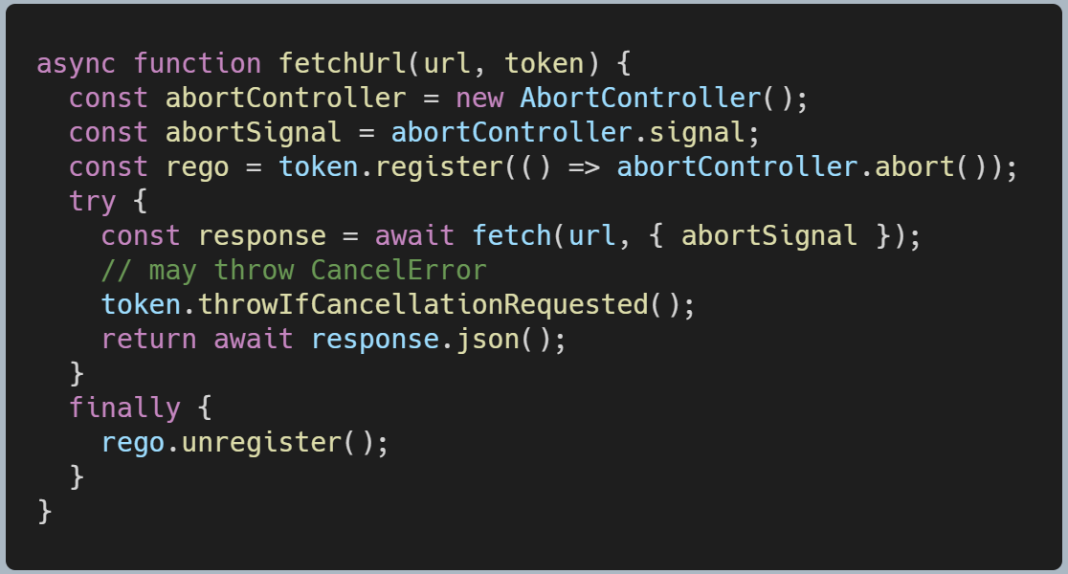
A typical code pattern
For example, calling fetch for a URL while observing cancellation:
Notes:
AbortController doesn’t support hierarchical cancellation yet (what CreateLinkedTokenSource does in .NET), but the discussion in underway.
Advanced use: can possibly be integrated with Node.js Async Hooks.

Slide 12
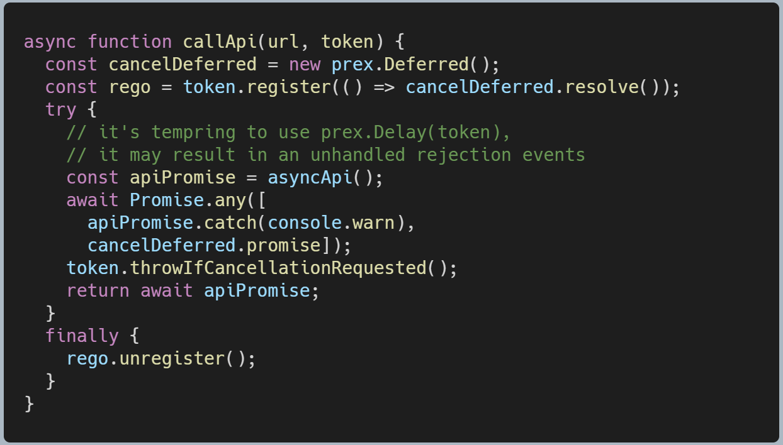
APIs that can’t be cancelled natively
There is not much we can do, besides we can become disinterested in the results and bail out earlier by using a dedicated cancellation promise and Promise.any:
Notes:
AbortController doesn’t support hierarchical cancellation yet (what CreateLinkedTokenSource does in .NET), but the discussion in underway.
Advanced use: can possibly be integrated with Node.js Async Hooks.

Slide 13
Demo time
https://github.com/noseratio/cancellation-talk
Or simply search for “@noseratio”
A pure client-side JavaScript app that draws a mouse trail using canvas.

Slide 14

Final point
If you already use and love the cancellation pattern in .NET/C#, bring it on to JavaScript/TypeScript, both for front-end and back-end!

Slide 15
References
ECMAScript Cancellation (the current TC39 proposal)
Cancellation in Managed Threads (in .NET)
Promise Cancellation Is Dead — Long Live Promise Cancellation, by Ben Lesh (@BenLesh)
Promise Extensions for JavaScript (prex), by Ron Buckton (@rbuckton)

